Slide 1
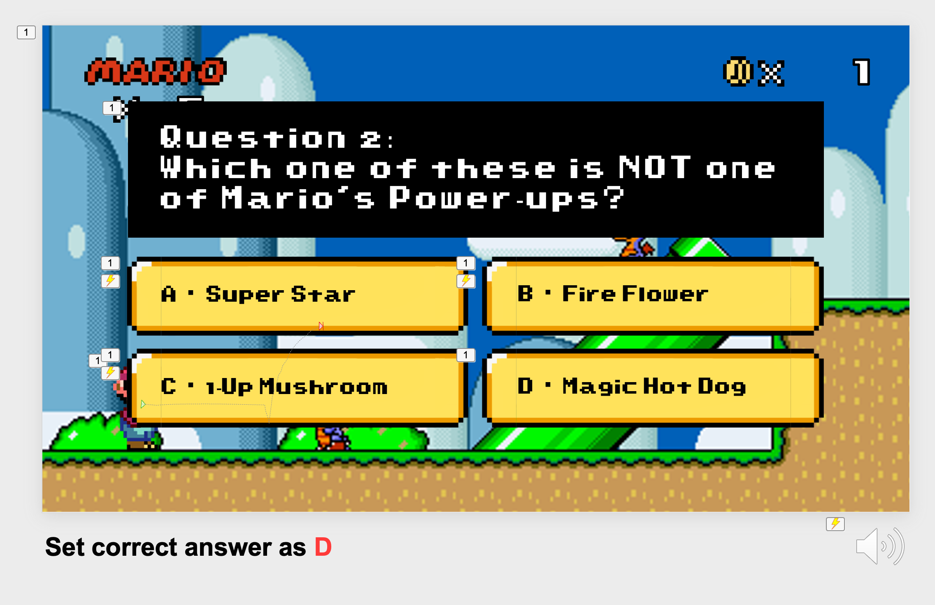
Thank you for downloading!
In case the fonts don’t work, try installing these onto your computer!
Super Mario World
https://www.dafont.com/super-mario-world.font
Typeface Mario World Pixel Filled
https://www.fontspace.com/typeface-mario-world-pixel-font-f56447
Tips:
Use the arrow keys to navigate between slides
Use the mouse to select the correct answer, then use the right key to move to the next question
Set the correct answer as suggested below the slide
@dstoryco

Slide 2
– D Story Co –
Presents

Slide 3

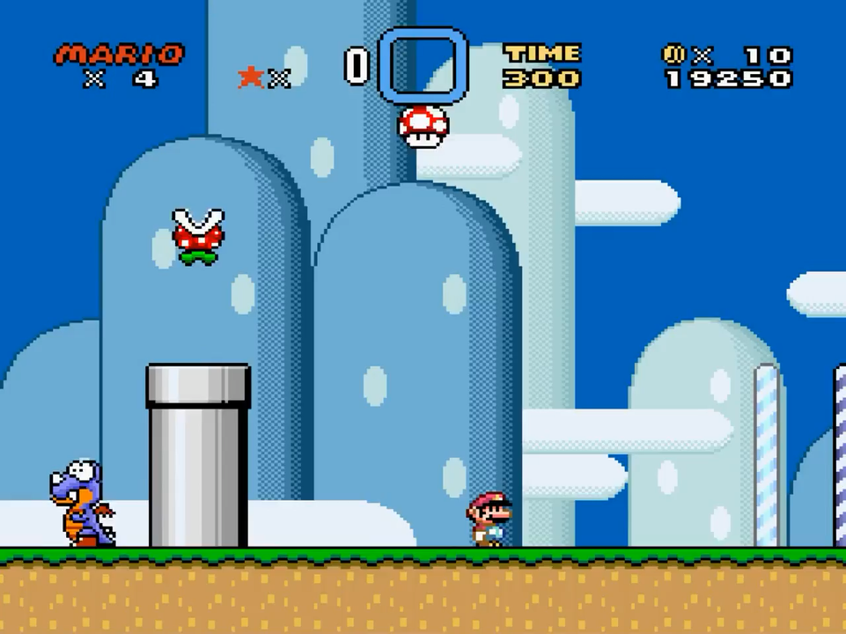

Super Mario Quiz
MARIO A . . . EMPTY
MARIO B . . . EMPTY
MARIO C . . . EMPTY
ERASE DATA
Background music:

Slide 4
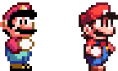
YOSHI’S ISLAND 1
x11

Slide 5
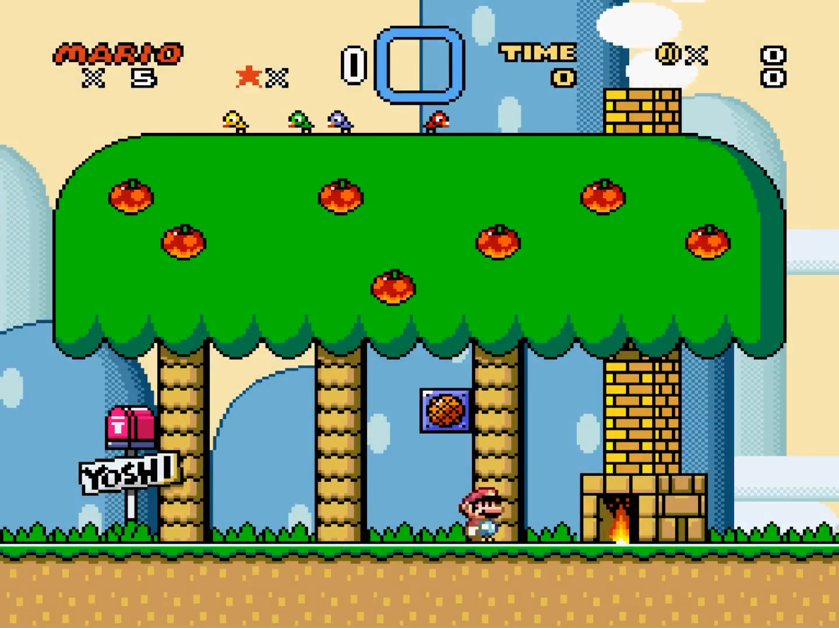
Answer questions correctly to get coins and save Princess Peach from Bowser!

Slide 6



0
5
Question 1:
Which game did Mario first get to ride on Yoshi?
A . Super Mario 64
B . Super Mario World
C . Super Mario Bros
D . Super Mario Bros 3
Set correct answer as: B

Slide 7
1
5
Question 2:
Which one of these is NOT one of Mario’s Power-ups?
A . Super Star
B . Fire Flower
C . 1-Up Mushroom
D . Magic Hot Dog
Set correct answer as D

Slide 8
2
Question 3:
What is the name of Mario’s racoon-like suit that lets him glide through the air?
5
A . Tanooki Suit
B . Sugar Glider Suit
C . Flight Suit
D . Racoon Suit
Set correct answer as A

Slide 9
3
Question 4:
In the original Super Mario Bros. game, Mario’s iconic overalls weren’t blue.
They were…
5
A . Green
B . Camouflage
C . Red
D . Yellow
Set correct answer as C

Slide 10
4
5
Question 5:
Who created Mario?
A . Kensuke Tanabe
B . Shigeru Miyamoto
C . Hisashi Nogami
D . Elon Musk
Set correct answer as B

Slide 11


5
5

Slide 12


5
5
Question 6:
Which of these roles has Mario NOT appeared in a game?
A . Golfer
B . Chef
C . Librarian
D . Carpenter
Set correct answer as C

Slide 13


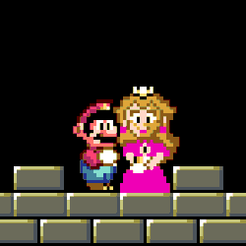
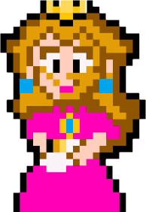
5
5
Thank you to our hero, Mario for restoring peace to our kingdom!

Slide 14
Game
Over
Click to try again

Slide 15

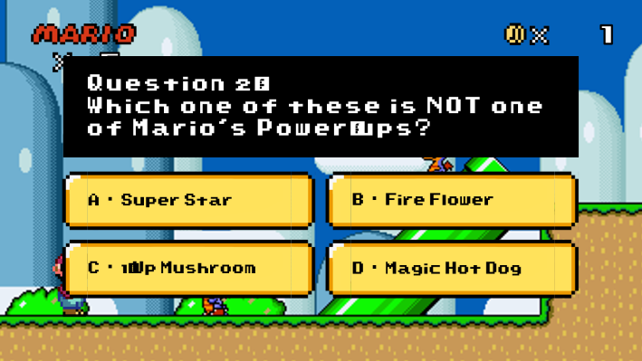
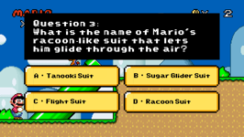
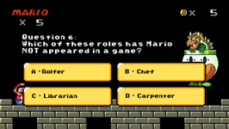
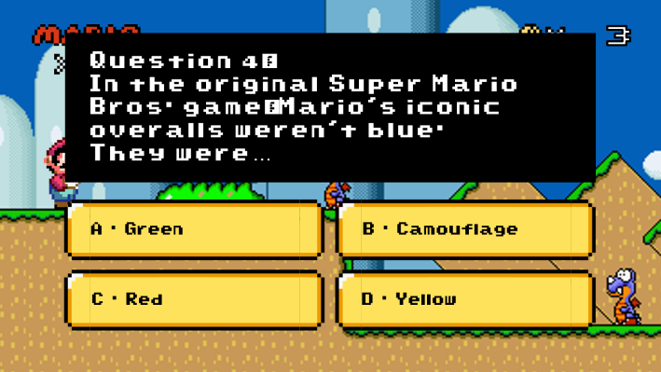
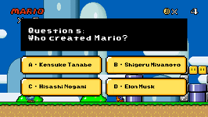
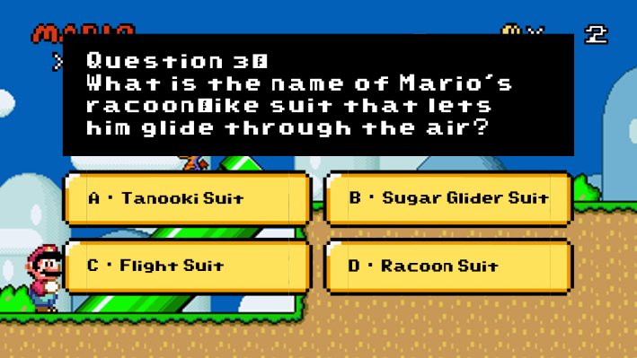
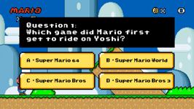
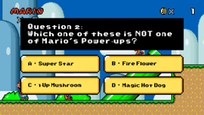
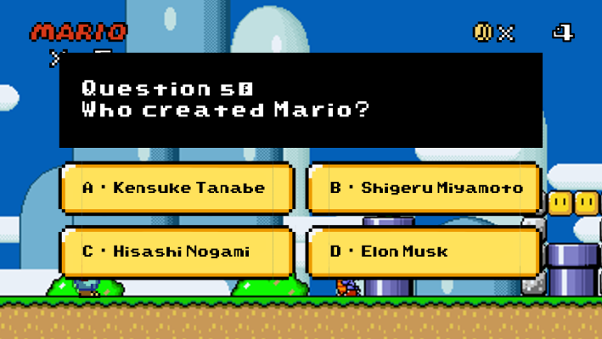

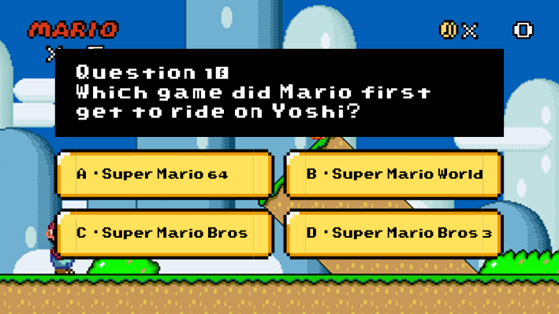
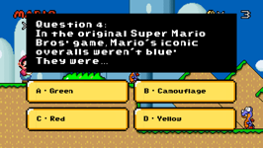
Choose your level

